Slide 1
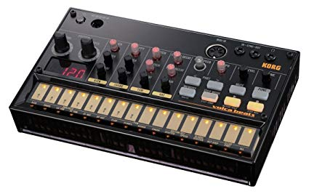
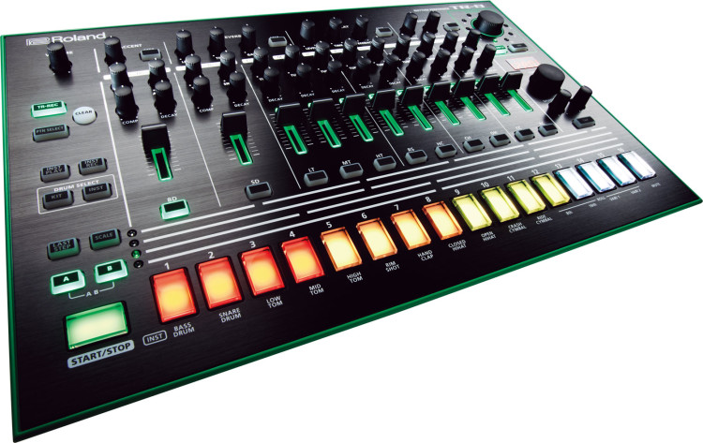
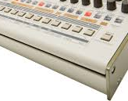
NuDrum
Minimalist polirhythm and polymetric drum machine

Slide 2
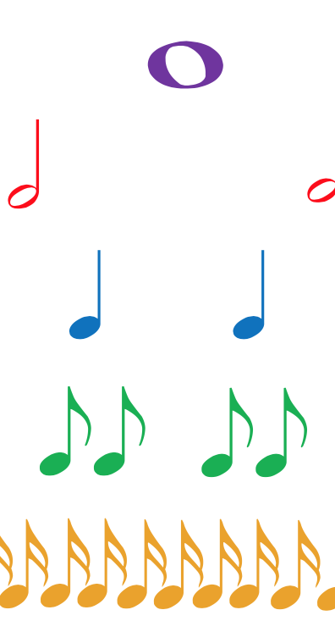
Rhythm
What is it?
The sense of rhythm was developed in the early stages of hominid evolution by the forces of natural selection to induce battle trance, promote the development of a defense system of early hominids.
In Sub-Saharan Africa it evolved in complex forms such as multi-layered, polyrhythm and simultaneous rhythms in more than one time signature.

Slide 3

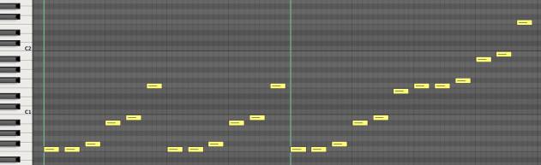
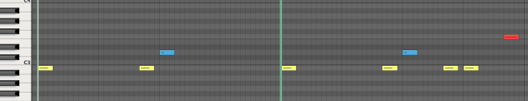
Polyrhythm
Polyrhythm
Simple
What is it?
A polyrhythm is the simultaneous use of two or more conflicting rhythms that are not readily perceived as deriving from one another, or as simple manifestations of the same meter

Slide 4
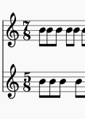
Polyrmetric
What is it?
Rhythm in music is characterized by a repeating sequence of stressed and unstressed beats and divided into bars organized by time signature and tempo indications.
* Usually, modern drum machine can be set on a single time signature forcing performer to play all the rhythm in a strict way.

Slide 5
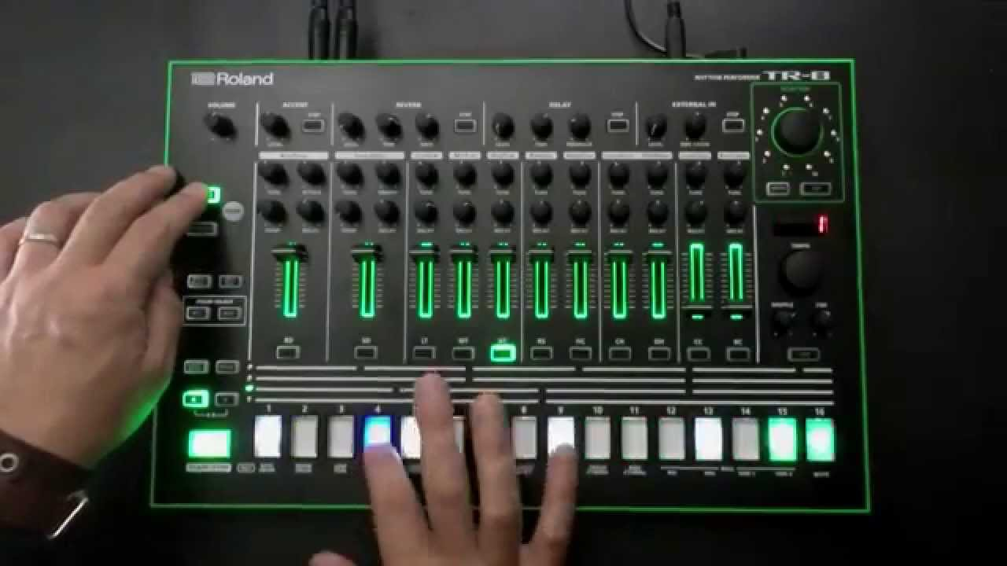
Old School
Roland TR-8

Slide 6
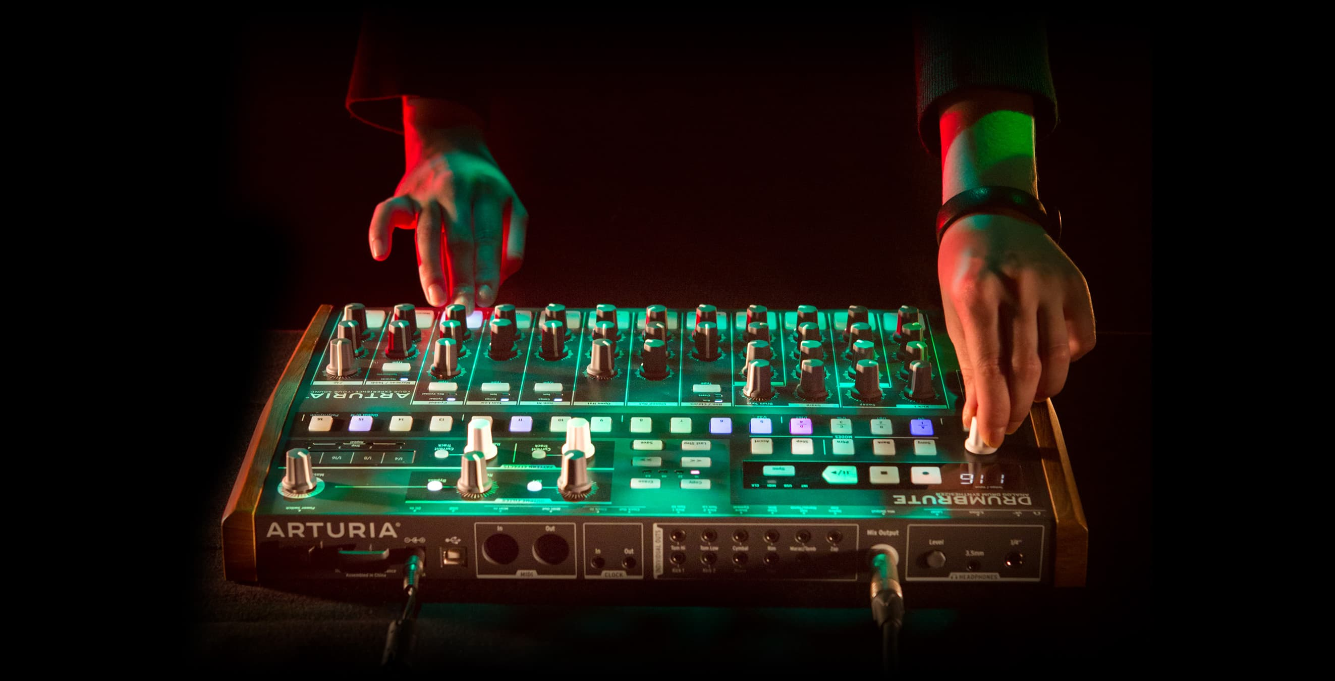
New Age
Arturia Drumbrute

Slide 7

Pros & Cons
What are they missing?
PROS
CONS
Hands-On
Ready for Live
Plug & Play
Analog taste
Hard for newbie
Constraint music style
Expensive
Cooperative
Photo by mwangi gatheca on Unsplash

Slide 8

How to improve it
Looking for a new concept
Patterns to understand rhythm and music
Sounds to learn how to mesh instruments
Free from rhythmical limits and time signature
Open Source
Minimalist interface
Photo by rawpixel on Unsplash

Slide 9





Tools
Libraries
AngularJs – manage GUI and Objects
PizzicatoJs – work with Web Audio API
jQuery – play front-end effects
Hosting
Netlify – commit online
Firebase – manage storage and database

Slide 10
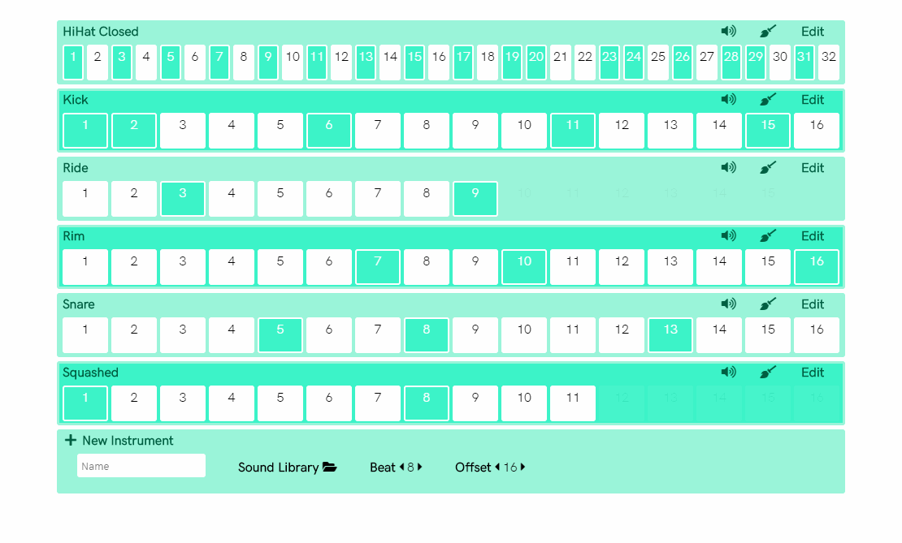
NuDrum
Spread your rhythms

Slide 11
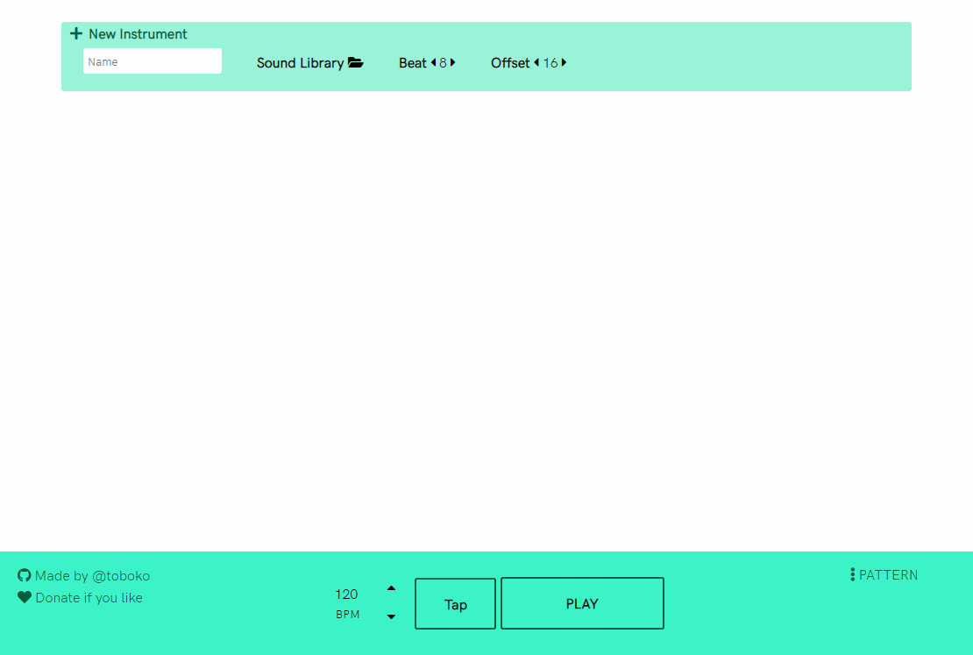
Share Patterns
Share and play rhythmical patterns

Slide 12
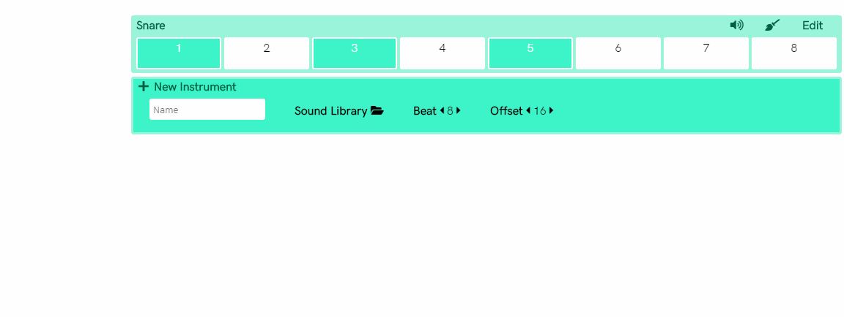
Unlimited Styles
Choose your best beat

Slide 13
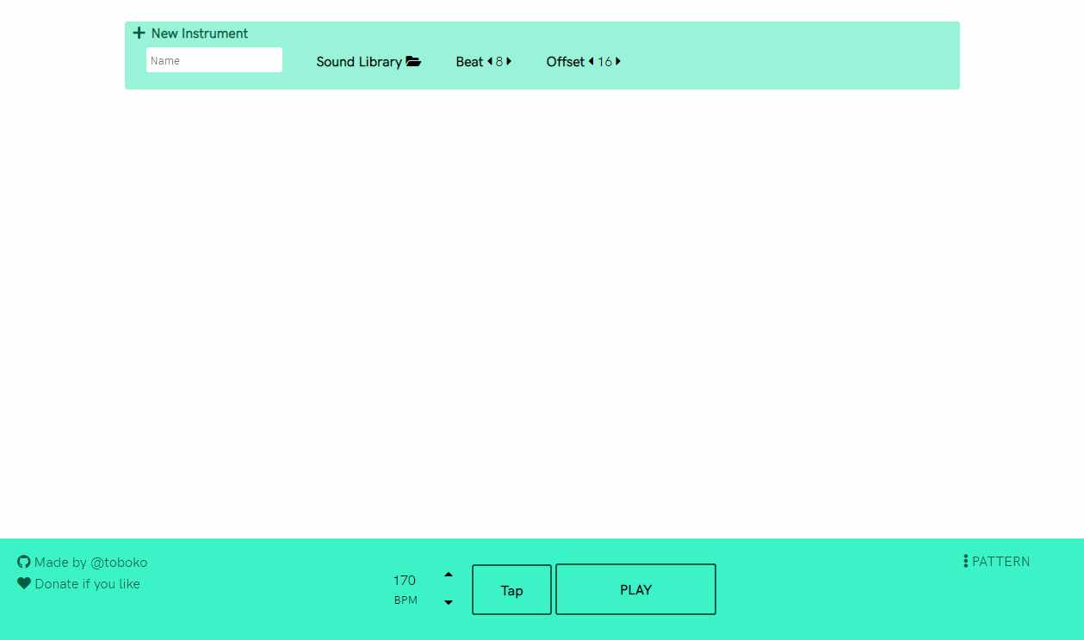
Your own Sound
Download or upload the best samples

Slide 14
Demo time

Slide 15
Thank you
Github Project
user : toboko
repository : nudrum-drum-machine
NuDrum
nudrum.netlify.com

